Slide 1
Data Mining for Stock Prediction
Vikas Mann (WQD180051)
Yong Keh Soon (WQD180065)
Shein Long (WQD180027)
Vee KIN (WQD180064)

Slide 2
Objective
The ultimate objective is to predict a Stock Price, based on historical stock data.
To develop an end to end Data Mining process for Stock Price prediction, by capturing the data using web crawling methods, performing data analysis and building Machine Learning model for prediction.
To gather the insights from data to provide investment recommendations.

Slide 3
Data Collection
Identified Data Sources
Stock Price
Malaysiastock.biz
Star Online
Yahoo Finance
Stock News
Malaysiakini
The Star Business
Stock Tweets
Twitter
Stock Forum Posts
Major Forex
XE.com
Commodities
Gold, Crude Oil etc.
Web Crawler
RSS Feed
Tweeter API
Web Crawler

Slide 4
Data Management
Storage of Data
Data is stored in Google BigQuery (GBQ), by Google Cloud Platform
Google Big Query is a
fast,
highly scalable,
cost-effective,
and fully managed cloud data warehouse for analytics,
with built-in machine learning.
Direct Data Ingestion using Google GBQ library (pandas_gbq) in Python.
Two important functions in pandas_gbq library
Read_gbq – load data from Google Big Query
To_gbq – write a dataframe to Google Big Query Table

Slide 5
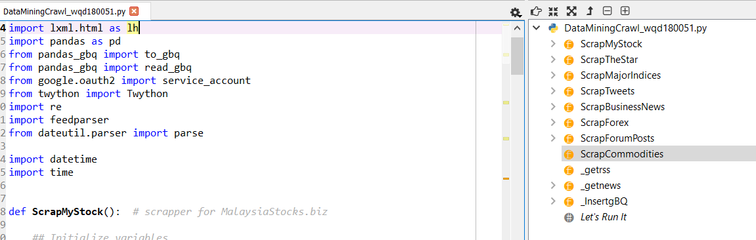
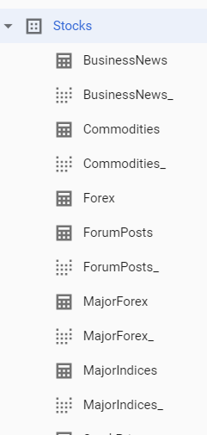

Data Management
Perform web based
Scrapping
Each function after scrapping, call this function to insert into Google Big Query
Python Script
Insert data into Google BigQuery Schema
DB Schema

Slide 6

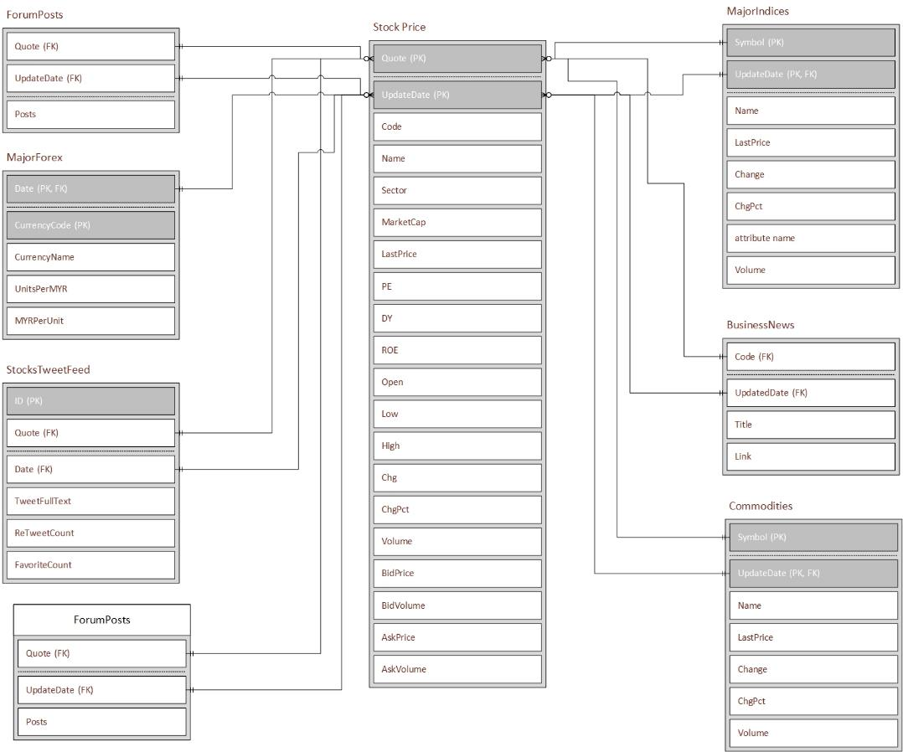
Data Management
The database schema consists of 7 tables
StockPrice (Primary)
BusinessNews
ForumPosts
StocksTweetFeed
MajorForex
MajorIndices
Commodities

Slide 7




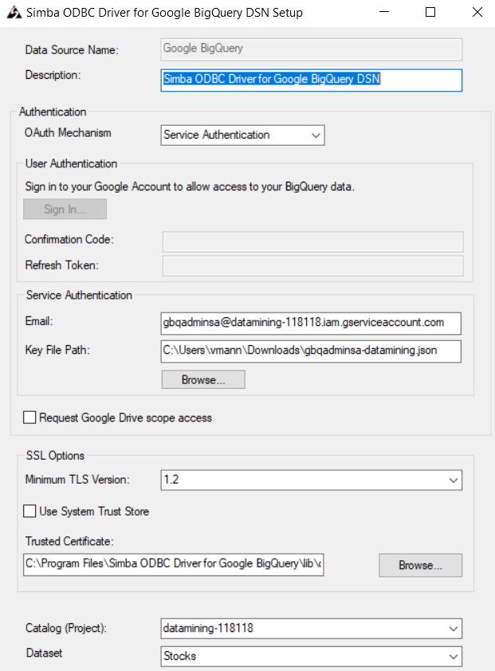
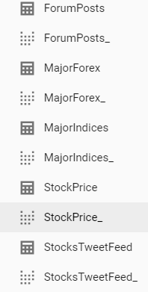
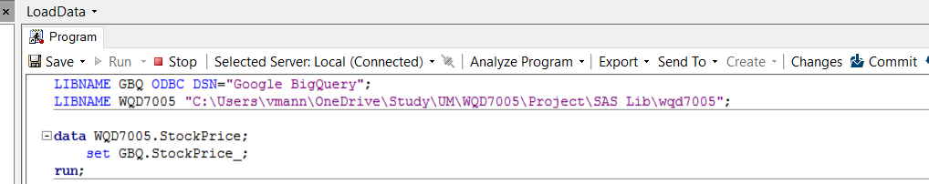
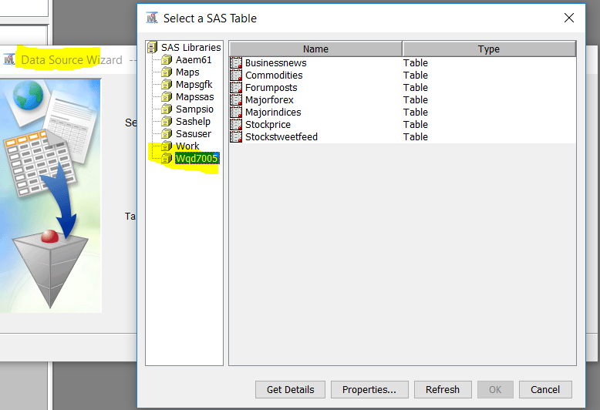
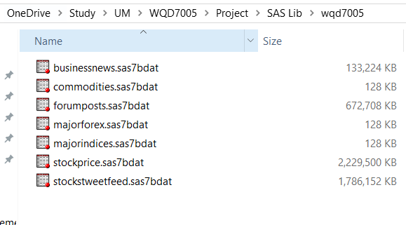
Data Ingestion and Integration
Google BigQuery (GBQ) is
exposed through Table views
Simba ODBC Driver is used
to directly read from GBQ
SAS Enterprise Guide uses Simba
ODB driver and create SAS Tables
SAS Enterprise Miner imports the SAS Tables
in a new library and perform further processing
DB Schema

Slide 8
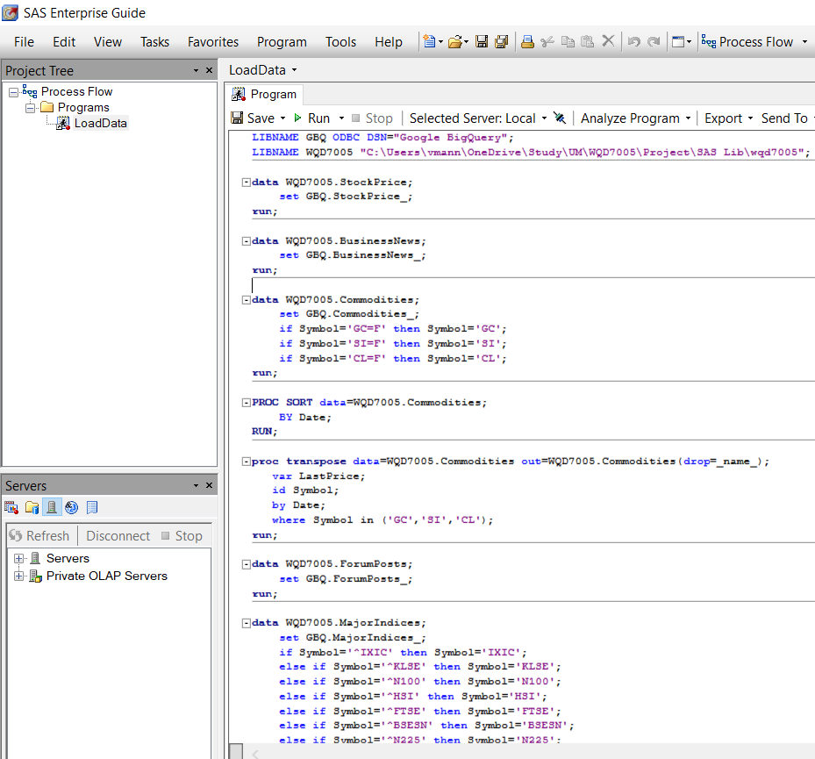
Processing of Data (SAS Enterprise Guide)
Steps in SAS Enterprise Guide to import and process Data
Create a new library for ODBC Source
Create a new library for imported SAS Tables
Import from ODBC Source library to new SAS Tables Library
Perform Sorting of Data
Perform Transposing of Data for below tables
Commodities
MajorIndices
MajorForex

Slide 9
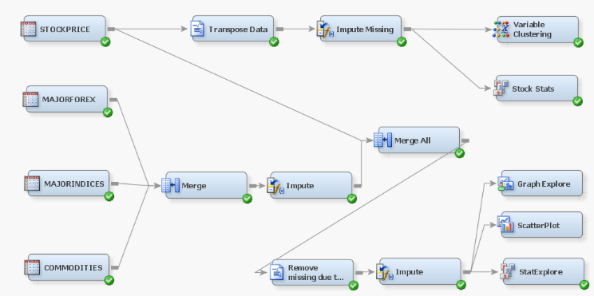
Processing of Data (SAS Enterprise Miner)
Steps in SAS Enterprise Miner
Import the new Library created during SAS Enterprise Guide Processing
Create new Data Sources from the new Imported library
COMMODITIES
MAJORFOREX
MAJORINDICES
STOCKPRICE
Create new Diagram for Data Processing and Analysis
Data Input
Data Processing
Data Analysis

Slide 10
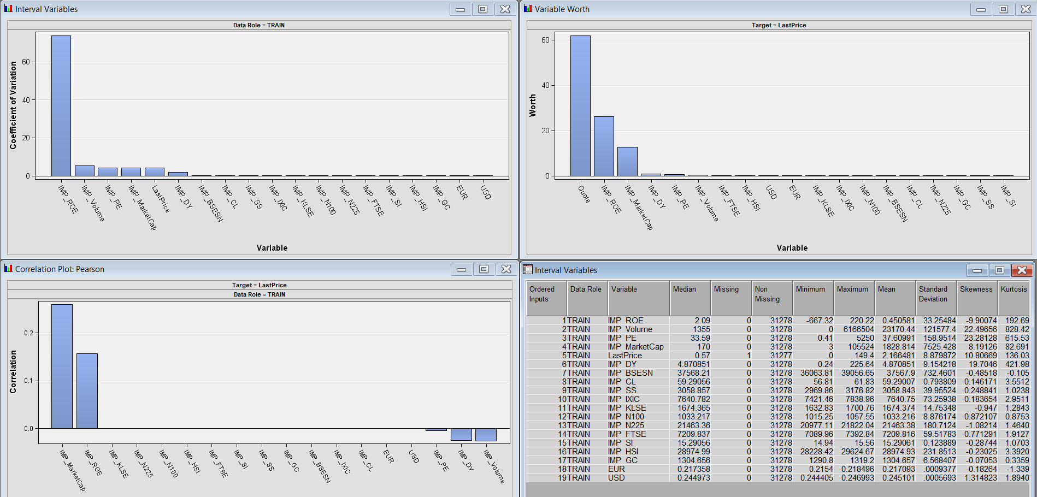
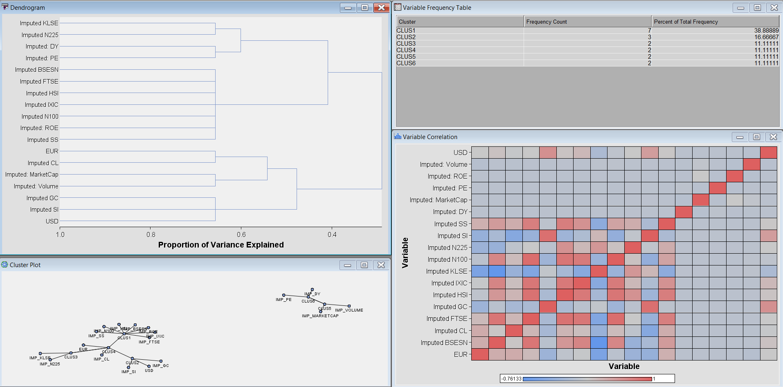
Processing of Data (SAS Enterprise Miner)
Variable Correlation / Co-Variance

Slide 11
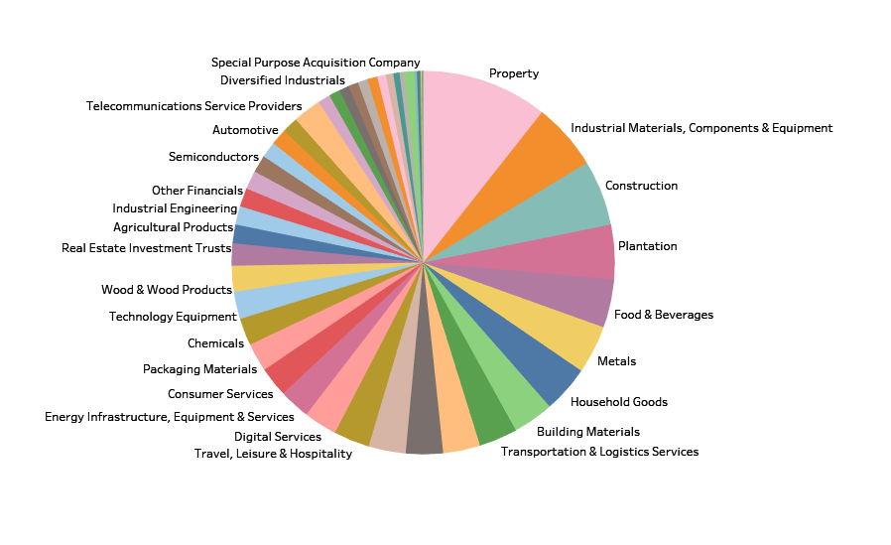
Data Interpretation
This chart displays composition of different stocks by sector. The highest stocks i.e. 102, are from Property sector.

Slide 12
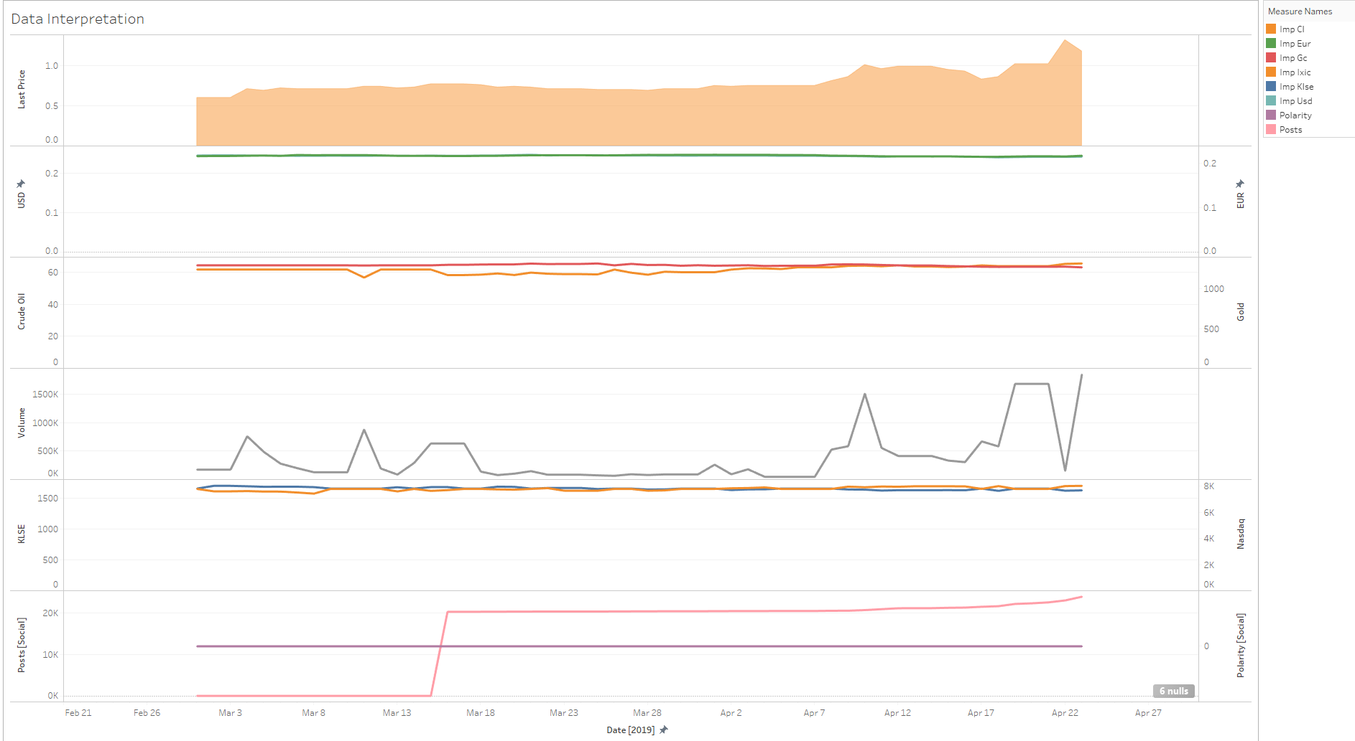
Data Interpretation
Relation of Target Variable with other Variables
This graph shows how the Target Variable i.e. Stock Last price, changes with other important variables i.e. major currencies, commodities, Stock volume, Stock exchange Indices, and Social Sentiments.
Crude oil price, stock trade volume, social posts count found to be having positive impact on Stock Last price.

Slide 13
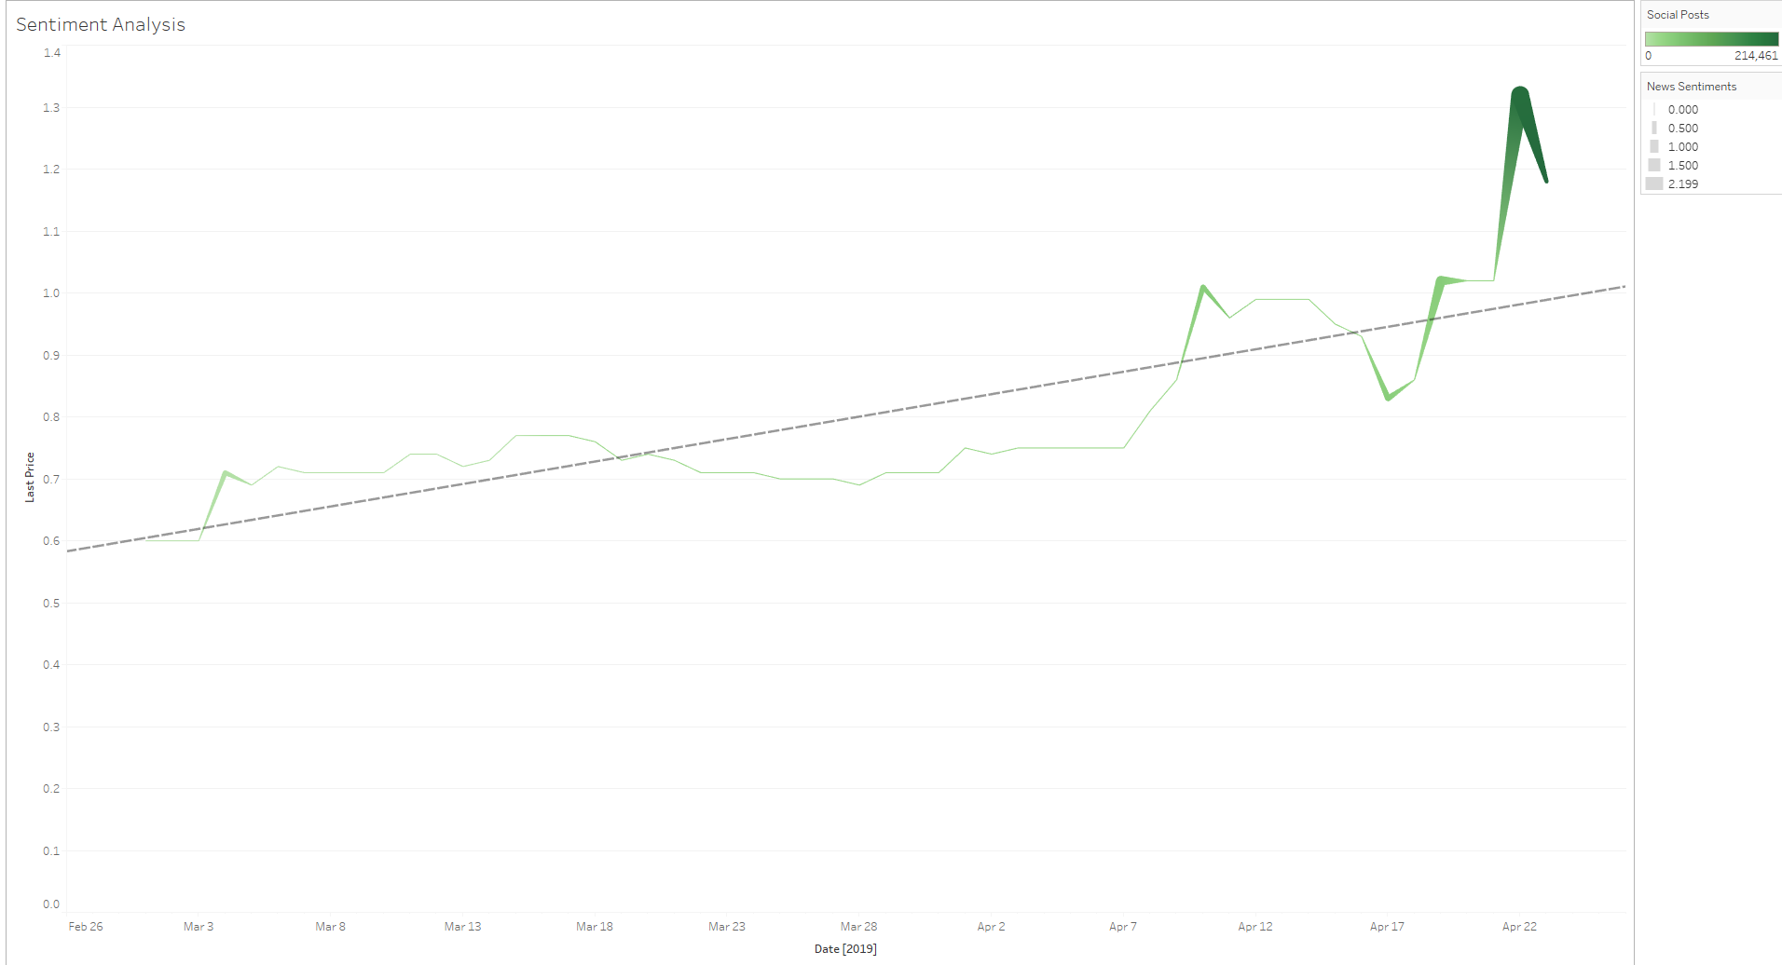
Data Interpretation
Social Sentimental Analysis
This chart clearly shows impact of social sentiments on Stock Last Price. The stock price is moving up during the positive social sentiments.

Slide 14
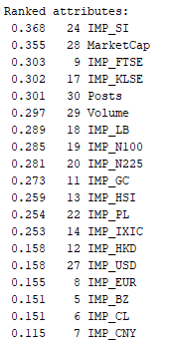
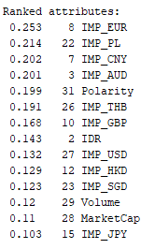
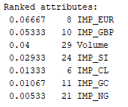
Data Modeling – Feature Selection
Feature Selection Method | Total selected Features | Selected Features
Info Gain Evaluation | 19 | IMP_SI,MarketCap,IMP_FTSE,IMP_KLSE,Posts,Volume,IMP_LB,IMP_N100,IMP_N225,IMP_GC,IMP_HSI,IMP_PL,IMP_IXIC,IMP_HKD,IMP_USD,IMP_EUR,IMP_BZ,IMP_CL,IMP_CNY
Correlation Evaluation | 14 | IMP_EUR,IMP_PL,IMP_CNY,IMP_AUD,Polarity,IMP_THB,IMP_GBP,IDR,IMP_USD,IMP_HKD,IMP_SGD,Volume,MarketCap,IMP_JPY
Logistic Regression P-value | 7 | IMP_EUR,IMP_GBP,Volume,IMP_SI,IMP_CL,IMP_GC,IMP_NG

Slide 15
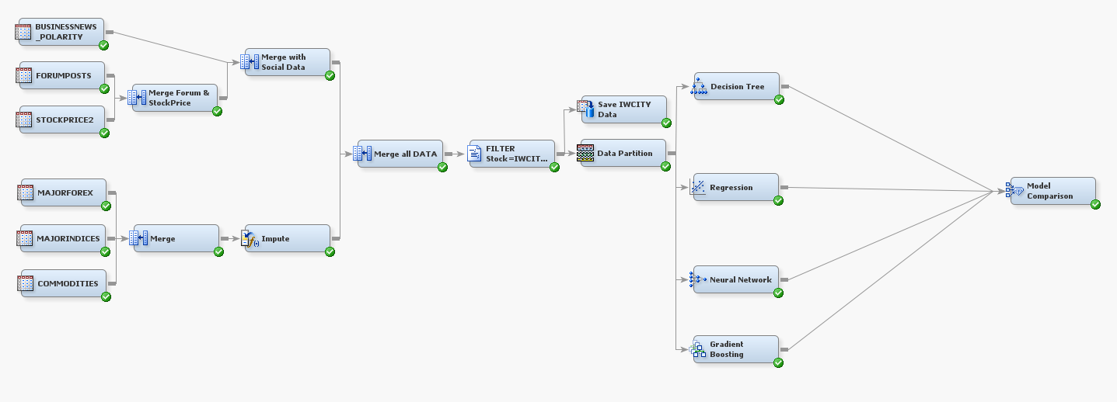
Data Modeling – Machine Learning Models
Data Input
Data Integration
Data Transformation
Model Development
Model Evaluation

Slide 16
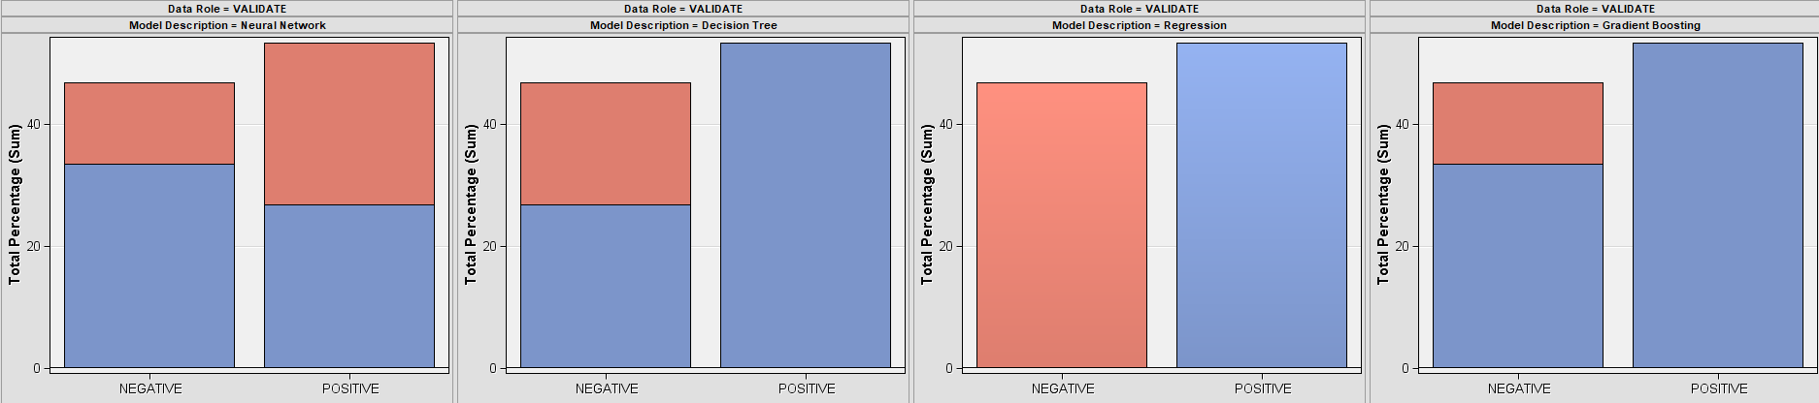
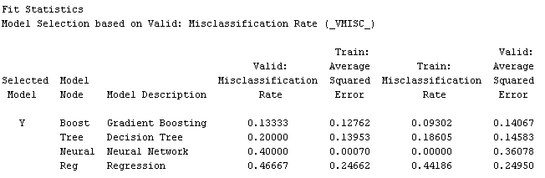
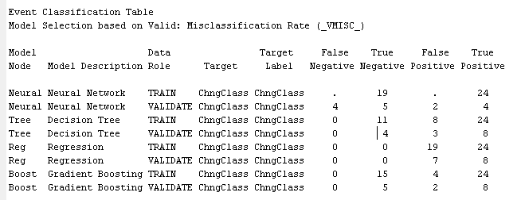
Data Modeling – Model Evaluation

Slide 17

Data Modeling – Model Evaluation
Models | % Accuracy | % TP Rate | % F-Measure | % ROC AUC
Decision Tree | 80 | 72.7 | 84.2 | 78.6
Logistic Regression | 53 | 53.3 | 69.6 | 50.0
Neural Network | 60 | 66.7 | 57.1 | 64.3
Gradient Boosting | 87 | 80.0 | 88.9 | 96.4

Slide 18
Data Modeling – Insights
Gradient Boosting is evaluated as the best model.
Features that impacts the Stock Price (IWCITY) most
Euro Currency Exchange rate
Great Britain Currency Exchange rate
Stock Volume
Silver Price
Crude Price
Gold Price
Natural Gas price

